Slide 1
Food Technology Coursework
Template border sheets
USE THIS FOR YOUR FRONT COVER

Slide 2
GCSE Supermarket Speciality Range
J Bloggs

Slide 3
Design Brief Analysis
CONTEXT: Ready made products
Readymade food products are an ever expanding market. A supermarket wishes to extend the current range of savoury ready meals and ready made desserts.
Design Task 3
Design and make a savoury or sweet chilled ready made product that could be sold from a supermarket’s ‘speciality range’.

Slide 4
Design Brief Analysis:
CONTEXT: Ready made products
Readymade food products are an ever expanding market. A supermarket wishes to extend the current range of savoury ready meals and ready made desserts.
Design Task 3
Design and make a savoury or sweet chilled ready made product that could be sold from a supermarket’s ‘speciality range’.
As a starting point brainstorm the brief and use lots of headings like the ones shown here. (Don’t just copy this one though!) Include all the highlighted key words above
Design Brief Analysis
Environmental Issues
Target market needs
Speciality Ranges
Existing Products
Materials & Components
Scales Of Production

Slide 5
Specialist Research:

Slide 6
Environmental Issues:

Slide 7
Questionnaire:

Slide 8
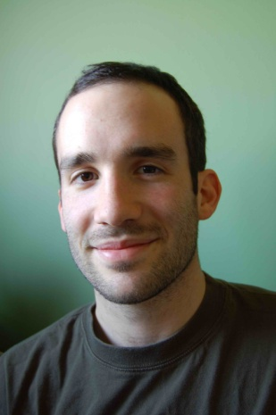
Research Analysis & User Profile:
facebook
XXXXXXX
Logout
XXXXXXX is eating Cheesecake and drinking Coffee at home after a long day
XXXXXXX is eating Cheesecake and drinking Coffee at home after a long day
Wall
Info
Photos
Videos
Basic Information
Networks:
Sex: Male
Birthday: 10/04/1988
Hometown: Georgia
Relationship Status: Single
Political Views: N/A
Religious Views: Catholic
View photos of XXXXXX(5)
Send XXXXXXXX a message
Poke message
Personal Information
Information
Activities: Basketball, Swimming
Interests: Computers
Favourite Music: Pop
Favourite Movies: Pitch Perfect
Favourite TV Shows: Simpsons
Favourite Books: The hunger games
Dietary Needs: None
Networks:
Birthday: 10/04/1988
Political: N/A
Religion: Catholic
Hometown: Georgia
Further Information
Favourite Food: Waffles
Favourite Fruit: Pineapple
Favourite Cuisine: Italian
Favourite Comfort Food: Ice cream
Best Starter Dish: Prawn Cocktail
Best Main Course: Sausage Casserole
Best Dessert: Cheesecake
Favourite Spice/Flavour: Cumin
Preferred Cooking Style: Italian
Favourite Supermarket: Wal-Mart
Photos
2 Albums
The Family
Updated last Tuesday
Beach Holiday
Updated two months ago

Slide 9
Specification

Slide 10
Initial Ideas 1

Slide 11
Initial Ideas 2

Slide 12
Recipe Planning & Evaluation 1 & 2

Slide 13
Recipe Planning & Evaluation 3 & 4

Slide 14
Recipe Planning & Evaluation 5 & 6

Slide 15
Existing Products Research

Slide 16
Development 1

Slide 17
Development 2

Slide 18
Development 3

Slide 19
Evaluation of development and ingredients list:

Slide 20
Flow Chart/Production Plan (QC & QA)

Slide 21
Controlled Assessment Diary:

Slide 22
Testing by client (3rd Party Testing):

Slide 23
Evaluation V Specification:

Slide 24
Nutritional Profile (Food in Focus):

